Slide 1

Gaining The Competitive Edge
M.Sc. Thesis 2021/2022 | Philipp Kläger

Slide 2
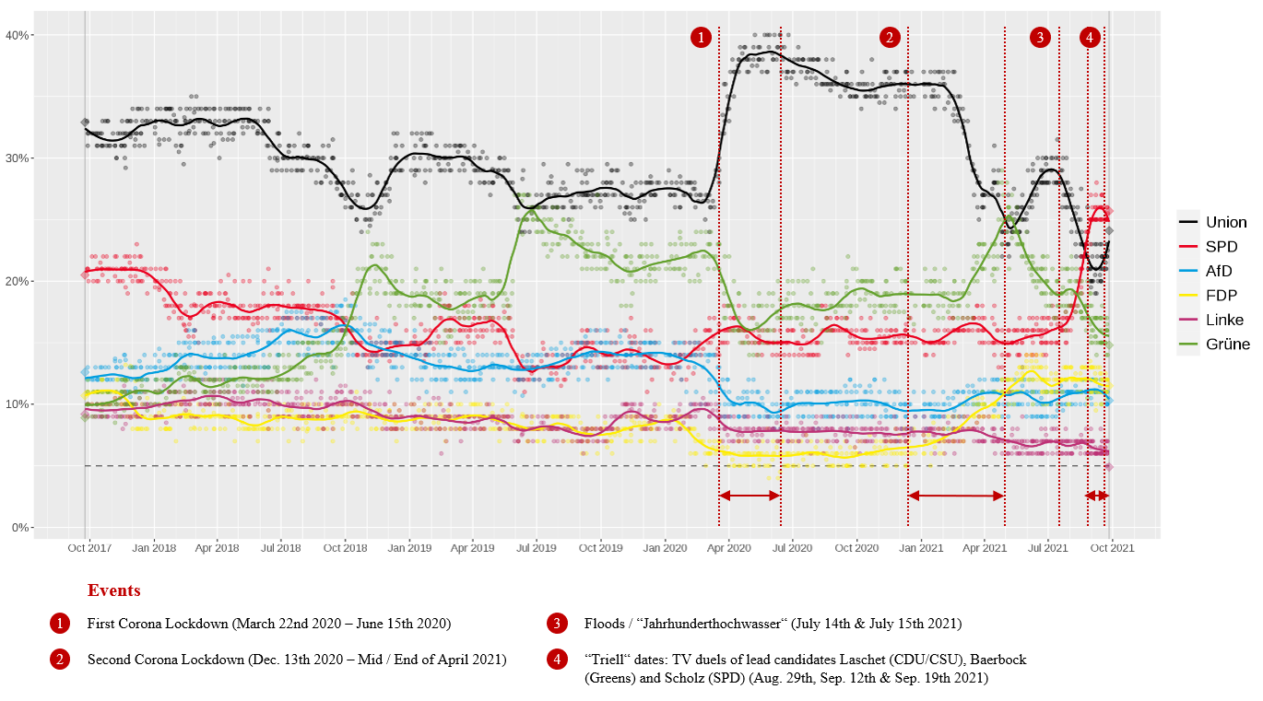
Gaining The Competitive Edge Analyzing the Importance and Potential Drivers of Success for Political Marketing Strategies Regarding the 2021 Federal Elections in Germany
Figure 1: Regression of Poll Data for the Major Political Parties in the last legislature period (2017-2021) (Sources: Politico 2021, Bundeswahlleiter 2021f, Eckstein et. al. 2021, Wahlrecht 2021, Wiwo 2021a, Wiwo 2021b, bpb 2021c)

Slide 3
Motivation
2021 Federal Elections in Germany: incumbent chancellor Angela Merkel (CDU/CSU) did not run for office again after 16 years as head of government
Campaigning: tight race for her succession & substantial voter fluctuation (see fig. 1)
→ SPD won by 1.6% - this represents a difference of only 700,000 votes out of 61 million voters
Political Marketing is capable tool to generate the competitive edge over opposing parties in tight campaign races like this one
Based on the work of Giavazzi et al. (2020), which identified a shift in text similarity between German political parties following terror attacks, this research conducted a topic-specific analysis to identify similar shifts in central election topics.

Slide 4
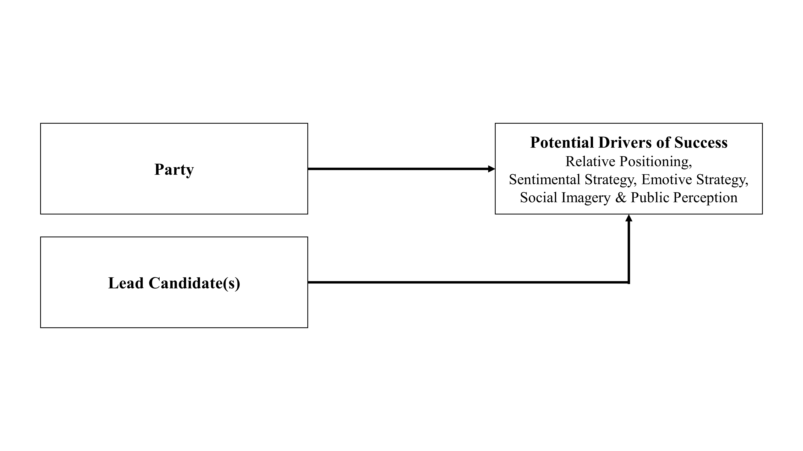
Conceptual Model
This research:
conducted a comprehensive text analysis of the party activities on Twitter regarding the 2021 Federal Elections in Germany
derived practical, data-driven recommendations for potential success drivers for political marketing regarding elections
Figure 2: Conceptual Model (own rep.)

Slide 5
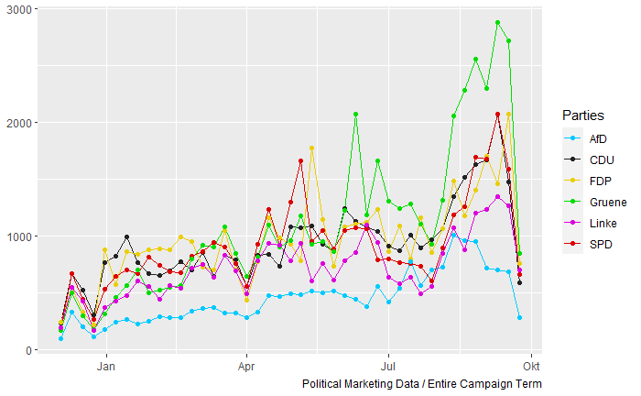
Data
Data Collection
Means: R script & Twitter Search API
Campaign Term: Dec. 8th 2020 – Sep. 26th 2021
Data: Two data sets from Twitter + party programs
1. Political Marketing (65 var. x 218,256 obs)
Twitter timelines of candidate accounts for the 2021 federal elections (based on the official candidate list)
2. User-Generated Discussions (70 var. x 297,775 obs.)
Election-related search queries on Twitter
3. Party Programs (2017 & 2021)
six major political parties in Germany
(AfD, CDU/CSU, FDP, Greens, The Left & SPD)
Figure 3: Total volume of tweets by the political marketing
accounts in the campaign period (own rep.)

Slide 6
Methodology
Sentiment & Emotion Analysis
Measures: Sentiment Index, Intensity Index, scores for sentiments and emotions
Method: Four Sentiment Lexicons (Syuzhet, Bing, Afinn & NRC) & One Emotion Lexicon (NRC)
General Stance Analysis I – Ideological Positioning
Relative positioning based on expert evaluations of party program positioning (left-to-right)
Method: ManifestoR RILE Index
General Stance Analysis II – Linguistic Positioning
Relative positioning based on wordscores
Method: Quanteda wordscore algorithm
Reference Texts: 2017 party programs
Reference Scores: 2019 Chapel Hill Expert Survey score for overall ideological position assigned to the reference texts
Topic-Specific Stance Analysis
Relative positioning based on topic-specific wordscores
Three central election topics: Corona (1), Environment / Climate Change (2) & Digitization (3)

Slide 7
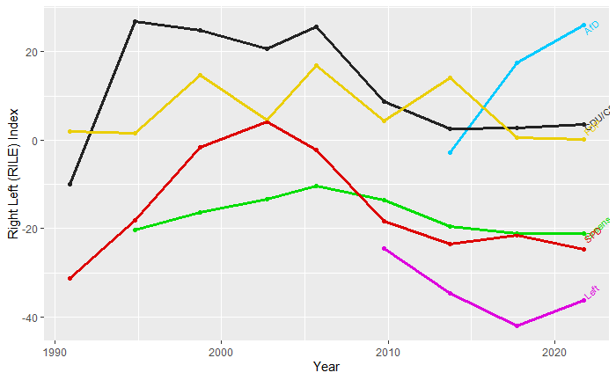
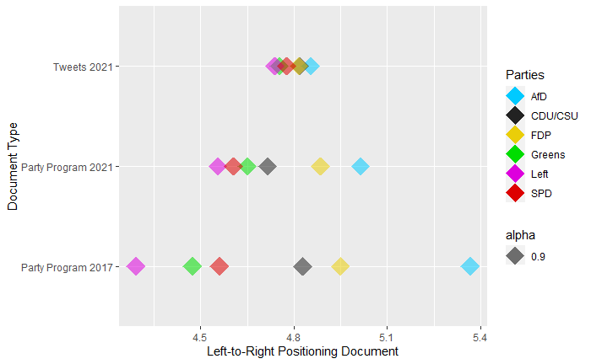
Results (I/II)
right-wing
In line with current research, the two incumbent government parties (CDU/CSU & SPD) have utilized more positive sentiment than the opposition parties
The text-similarity of the six major political parties has continuously and considerably increased between 2017 and 2021 party programs and campaign period tweets - thus resulting in the most similar relative positioning for all parties for the campaign period tweets.
left-wing
Figure 4: Relative Positioning of Major German Parties based on their overall ideological position (1990-2021) (own rep.)
Figure 5: Relative Positioning of Major German Parties based on their wordscores (2017 & 2021) (own rep.)

Slide 8
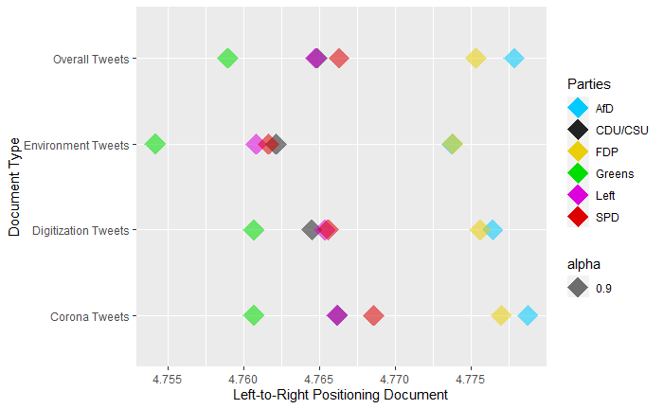
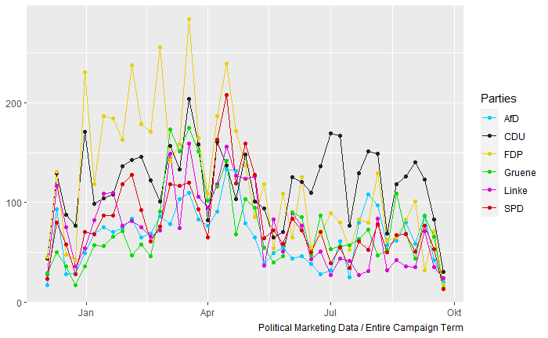
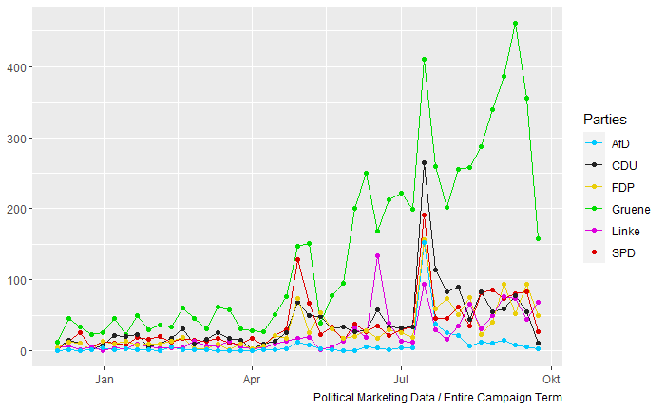
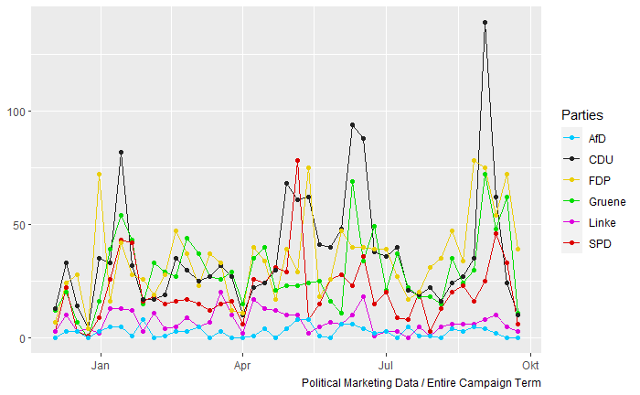
Results (II/II)
Several shifts in language by the parties: Corona (all parties more right-wing), Environment (all parties more left-wing) & Digitization (two shifts)
Three Campaign Phases:
Phase 1 – Corona (Dec. 20 – Apr. 21)
Phase 2 – Environment (May 21 – Aug. 21)
Phase 3 – Digitization (Sep. 21)
Figure 6: Relative Positioning of Major German Parties based on their topic-specific stances (own rep.)
Figure 7: Corona-specific Tweets (own rep.)
Figure 8: Environment-specific Tweets (own rep.)
Figure 9: Digitization-specific Tweets (own rep.)

Slide 9
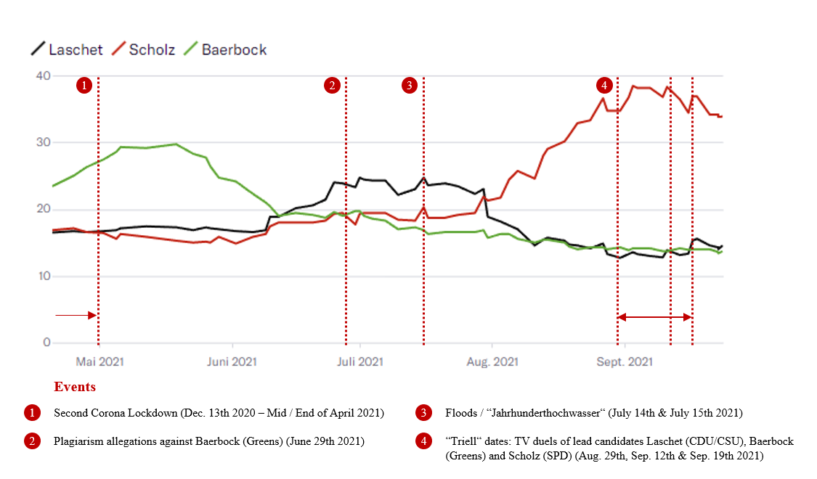
Conclusions & Marketing Implications
Increasing assimilation in text similarity raises the need for differentiation regarding central election topics (→ topic shifts) and sentimental and emotive strategies
Sentimental and emotive strategies are a suitable differentiating tool: the question of whether messages should be in the majority positively or negatively connoted is primarily determined by the incumbent status of parties.
Social imagery: public image of the lead candidate seems to be one of the central drivers for voter behavior.
Other suitable political marketing tools: Situational contingency + epistemic value
Figure 10: Polled preferences for the chancellor position in a comparison between lead candidates (Sources: Eckstein et. al. 2021, Wahlen 2021, bpb 2021c)

Slide 10
Sources
Bundeswahlleiter (2021f, November 16th): Bundestag elections 2021. Retrieved from: https://www.bundeswahlleiter.de/en/bundestagswahlen/2021/ergebnisse/bund-99.html#stimmentabelle13
Bundeszentrale für politische Bildung (bpb) (2021c, December 13th 2021): Jahrhunderthochwasser 2021 in Deutschland. Retrieved from: https://www.bpb.de/politik/hintergrund-aktuell/337277/jahrhunderthochwasser-2021-in-deutschland
Eckstein, C., Staub, N., Haas, S. & Thelitz, N. (2021, December 15th): SPD weiter auf Platz eins, grosse Koalition mit Mehrheit – die neuesten Umfragen zur Bundestagswahl 2021. Wie schneiden die Parteien vor der Bundestagswahl am 26. September ab, und welche Themen sind den Wählern wichtig? Ein regelmäßig aktualisierter Überblick in Zahlen. Neue Züricher Zeitung (NZZ). Retrieved from: https://www.nzz.ch/international/deutschland/bundestagswahl-2021-die-neusten-umfragen-zur-wahl-in-deutschland-ld.1605950
Giavazzi, F., Iglhaut, F., Lemoli, G. & Rubera, G. (2020): Terrorist Attacks, Cultural Incidents and the Vote for Radical Parties: Analyzing Text from Twitter, NBER Working Paper No. 26825, March 2020, Revised November 2020, JEL No. C45, D72, H56, p.3-64.
Liberini, F., Redoano, M., Russo, A., Cuevas Rumin, A. & Cuevas Rumin, R. (2018): Politics in the Facebook era: How reading political ads on Facebook affects our voting behavior (… and helped Trump to win the presidential election), in: Vox EU CEPR, Research-based policy analysis and commentary from leading economists. Retrieved on December 12th 2021. Retrieved from: https://voxeu.org/article/politics-facebook-era
Politico (2021, November 16th): Germany – 2021 general election. Social Democrats narrowly win German vote. Retrieved from: https://www.politico.eu/europe-poll-of-polls/germany/

Slide 11
Sources
Wahlen_DE (Wahlen) (2021, December 15th): Deutschland Wählt. Retrieved from: https://twitter.com/Wahlen_DE
Wahlrecht.de (Wahlrecht) (2021, December 15th): Sonntagsfrage Bundestagswahl. Retrieved from: https://www.wahlrecht.de/umfragen/index.htm
WirtschaftsWoche (Wiwo) (2021a): Wie verlief der erste Lockdown in Deutschland? Corona-Lockdown. Retrieved from: https://www.wiwo.de/politik/deutschland/corona-lockdown-wie-verlief-der-erste-lockdown-in-deutschland/26853384.html
WirtschaftsWoche (Wiwo) (2021b): So ist der zweite Lockdown in Deutschland verlaufen. Corona-Lockdowns. Retrieved from: https://www.wiwo.de/politik/deutschland/corona-lockdowns-so-ist-der-zweite-lockdown-in-deutschland-verlaufen/27076474.html

